Slide 1
CPSC 230: Intro to Computer Science Day 1
Sam Bernsen

Slide 2



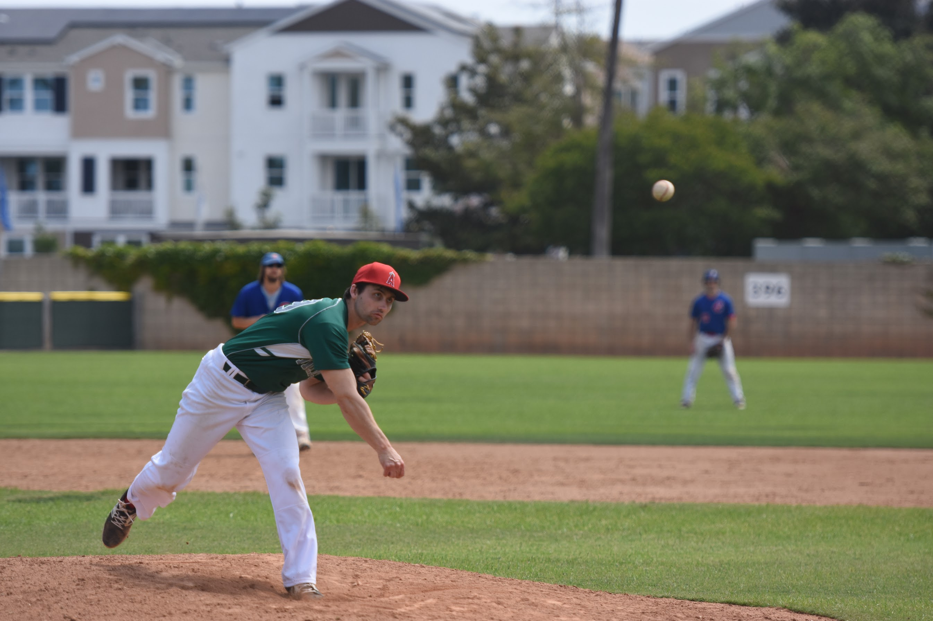
Graduate Student Instructor & EECS Masters Student
B.S. Computer Engineering at Chapman
1st semester teaching
Feedback welcome!
San Diego native
Hobbies: Baseball, golf, volleyball, frisbee

Slide 3

Experience: Cadence Design Systems Internship
Summer hardware verification internship
Programming language: Verilog & SystemVerilog
Team project: Sous Vide Controller RTL verification
Worked alongside Digital and Analog teams working on synthesis, place and route, and process node migration
Notes:
I can't really show much of the work I did because it is Cadence's intellectual property...but if you're more interested come talk to me

Slide 4
Classroom discussion
Who are you?
Name
Year (Freshman, sophomore, etc.)
Major
Least favorite drink
Any prior programming experience?

Slide 5
Quick Syllabus Overview

Slide 6
Questions?
Myself
Course content
Class policies
Requirements

Slide 7
Day 2: Computer Basics
How do computers "think" and operate?
Terminology
Programming languages

Slide 8
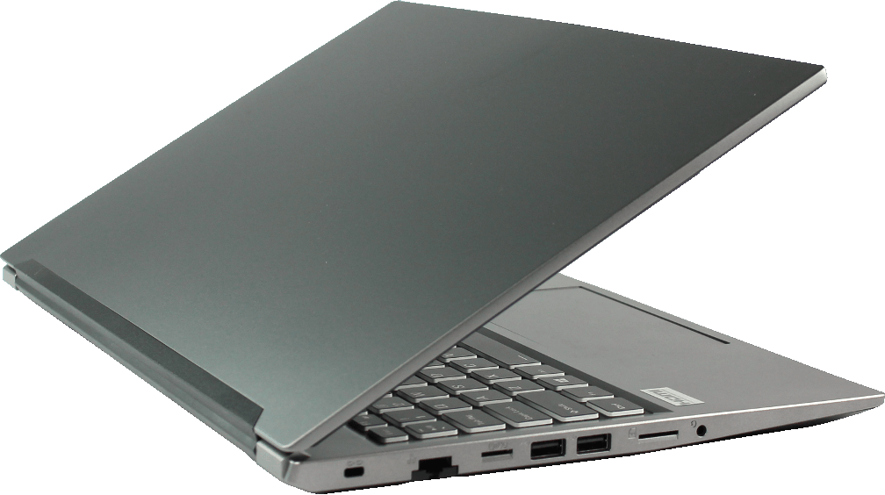
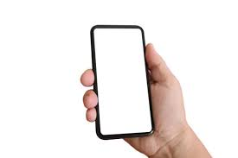
What is a Computer?
A device that processes data. It can:
Execute software programs
Perform mathematical operations
Transmit data via a computer network system
Assist in daily activities

Slide 9
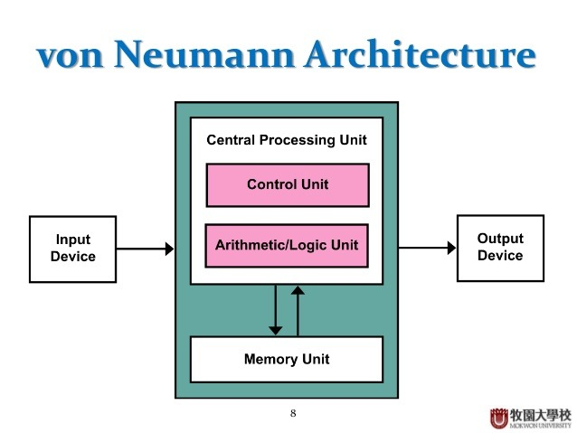
Basic von Neumann Architecture
Mouse
Keyboard
Trackpad
Display
Speakers
Printers
Notes:
“The most common architecture for most computers today is the von Neumann architecture. We interact with the computer through the input and output devices. Mouse, trackpad, and keyboard are examples of input devices. The computer works its internal magic and then outputs data through the output devices. Examples of output devices are displays, speakers, and less often today: speakers. In the von Neumann architecture, program data and instruction data are stored in the same memory location. The Harvard architecture separates storage for instructions and data. The heavy lifting of the computer occurs within the CPU. It is sort of the central brain of the computer. It interprets, processes, and executes instructions. It does mathematical and logical operations to transform data into more usable information output.

Slide 10
Basic Computer Components
CPU/Processor: processes instructions from software
Volatile memory
Main memory/RAM
Non-volatile storage
Hard disk drive
Flash memory (e.g. Solid state drives)
Read only memory
Input/Output
Network: communication between computers

Slide 11

How Do Computers "Think?"
All about DATA and INSTRUCTIONS
Tell the computer what data to operate on and what to do with the data
Fetch, Decode, Execute, Store (Repeat)
Binary: base 2 number system
Examples:
3₁₀ = 11₂
20₁₀ = 10100₂
ThePhoto by PhotoAuthor is licensed under CCYYSA.
Notes:
“Well, they don't exactly think, as we do. They take instructions and execute them in a 4 step process: Fetch, decode, execute, store. Yes, AI is all the rage and it does allow computer to mimic human decision making and generative capabilities. However, it still following an algorithm that is trained on data to produce an output.”
Explain the binary system

Slide 12
What is Programming?
Telling the computer what to do
A set of instructions
Manipulating values in memory
Sent to CPU for processing and output

Slide 13
Terminology
Computer science: the study of computer and computational systems
Computer scientists design and analyze algorithms to solve problems
Code: plain text computer program written in a particular programming language
In our case, we will be using the Python programming language
Software: programs, scripts, or applications that run on a computer
Provide instructions of hardware to perform operations
Script: a code file designed to execute as a program
Programming language: a tool we can use to write these instructions
Allows us to direct the computer's operation without using machine language
How tedious would that be !?!

Slide 14
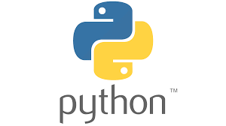


Programming Languages
High level languages: easy for humans to read; hard for computer to understand
Python
JavaScript
C++(ish)
Low level languages: harder for humans to read, easier for computer to understand (i.e. less steps to compile code into binary)
C
Cobol
Fortran
Assembly
Final form of code: binary
All languages eventually get converted to binary for the computer to understand

Slide 15
Why is CS Important?
So many industries rely on it!
Finance, transportation, semiconductor industry, healthcare, entertainment, meteorology, education, etc.
Connected world requires reliable computing and software
Computers without well optimized software are much less effective
Who doesn't use a computer on a daily basis?
Notes:
"Besides being a lucrative career, which is admittedly why some people enter the field, CS is a neat field!
Even if software programming isn't your thing, it allows you to branch off into other areas. Theoretical computer scientists take a mathematical twist on traditional CS by studying algorithm development and complexity theory.

Slide 16
Cool Application: Short Demo

Slide 17
Day 3: Python Introduction & Environment Setup
Why Python?
The power of python

Slide 18
Why Python?
Conceived in the late 80s by Guido van Rossum
Named after Monty Python
Python 3.0 released in 2008
General purpose and high-level
Easier to understand for new programmers
Closer to pseudo-code
FREE and open source
Loosely typed: implicit data type inference
Loosely typed:
a = 5
v.s.
Strongly typed:
int a = 5

Slide 19
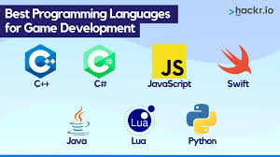

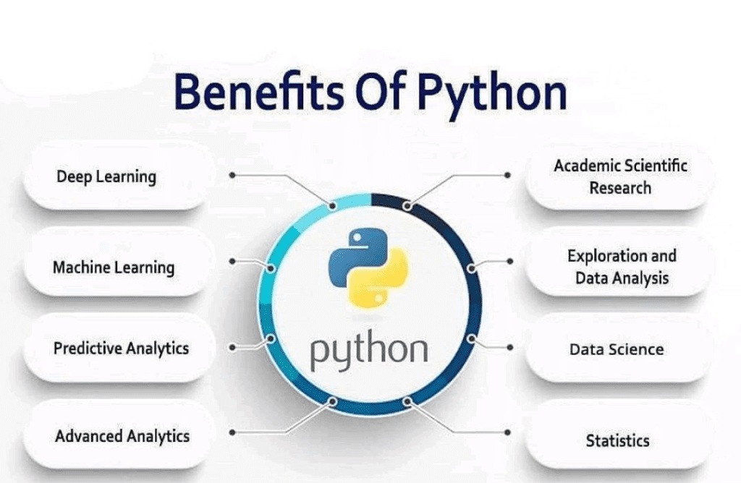
The Power of Python
Language most similar to English
Interpreted, not compiled
No need to explicitly invoke a compiler
Many use-cases:
Game development
Machine learning
Web development
GPU programming with PyCuda
Notes:
Interpreted vs Compiled:
Interpreted languages execute code line by line, compiling the code on the fly each time the program runs. Makes debugging easier because the interpreter generates errors immediately when there's a problem with a line of code.
Compiled languages: entire code is translated into machine language before execution. Compilation only done once

Slide 20



Text Editors & Setup
Setting up the environment
Let's dive in!
Possible local text editors (ideally most work done locally)
VSCode
PyCharm
Notepad++
Cloud services
GitHub Codespaces
Google Colaboratory
Programiz Online Interpreter

Slide 21
Hello World!

